Slide 1
Computer Organization & Assembly Language (CSC-205)
Lecture 2: Variables, Registers and Data Movement

Slide 2
Google Classroom code: p5vf35j
For text books, slides, assignments, course updates etc.

Slide 3
Importance of Assembly Language
Practically, the need for assembly language programming has decreased
However, the need to understand it has not decreased
Like programming in machine language, but easier – helps gain insight into computer organization and architecture
Builds understanding of high level language implementations and compiler construction concepts

Slide 4
D/F b/w High level and Low level Lang?
High-level languages are human-friendly. They are, thus, very easy to understand and learn by any programmer. C, FORTRAN, Java
Closer to natural languages
Make programs easier to read and write
Low level languages, on the other hand are closer to machines
Low-level languages are machine-friendly. They are, thus, very difficult to understand and learn by any human. Examples include assembly langauge, machine language

Slide 5
Assembly
Midway, whereas programming in machine language is extremely tedious, assembly language is still manageable
Assemblers convert assembly language to machine language

Slide 6
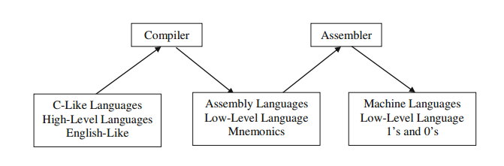

Slide 7
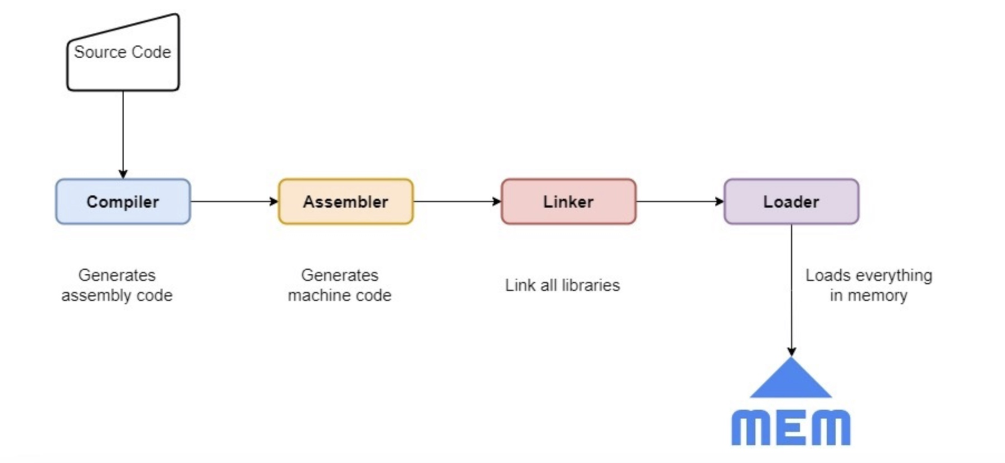
A compiler takes our source code and generates the corresponding assembly code. An assembler converts the assembly code to the machine code. A linker merges all the machine-code modules referenced in our code, whereas a loader moves the executable to RAM and lets it be executed by a CPU.

Slide 8
Are There Rules in Assembly Language?
• Most rules in assembly language are based on physical limitations of the target processor and its machine language. The CPU, for example,
requires two instruction operands to be the same size. Assembly language has fewer rules than C++ or Java because the latter use syntax rules to reduce unintended logic errors at the expense of low-level data access. Assembly language programmers can easily bypass restrictions characteristic of high-level languages.

Slide 9
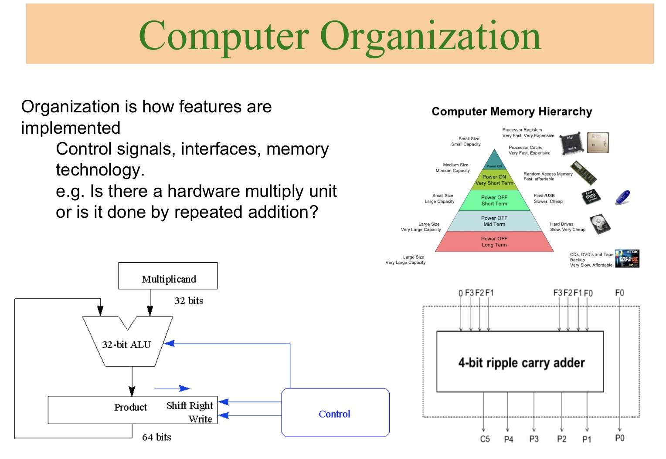

Slide 10
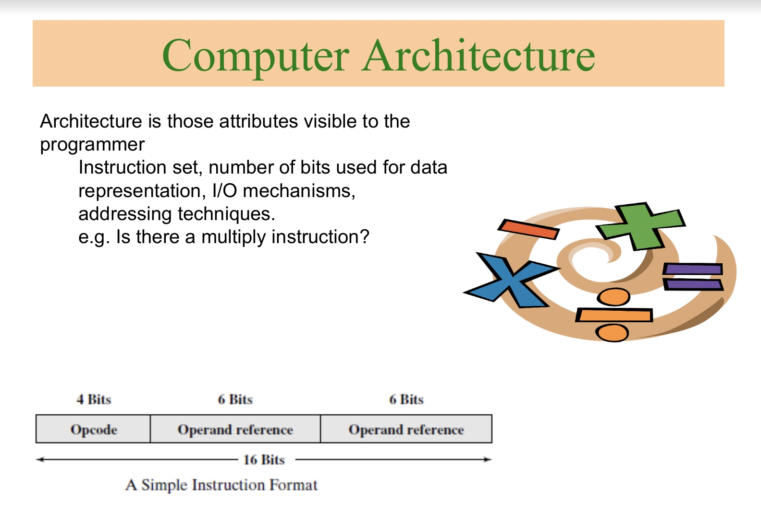

Slide 11
Is Assembly Language Portable?
A language whose source programs can be compiled and run on a wide variety of computer systems is said to be portable.
A C++ program, for example, will compile and run on just about any computer, unless it makes specific references to library functions that exist under a single operating system. A major feature of the Java language is that compiled programs run on nearly any computer system.
Assembly language is not portable, because it is designed for a specific processor family. There are a number of different assembly languages widely used today, each based on a processor family.

Slide 12
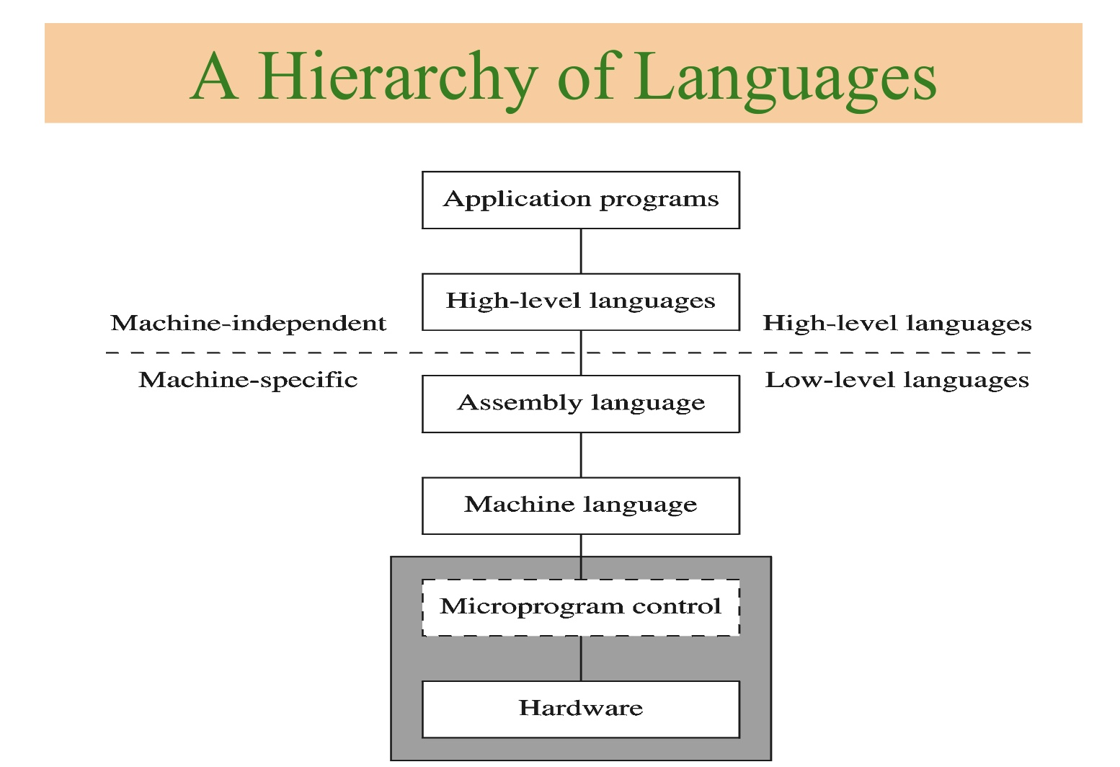

Slide 13
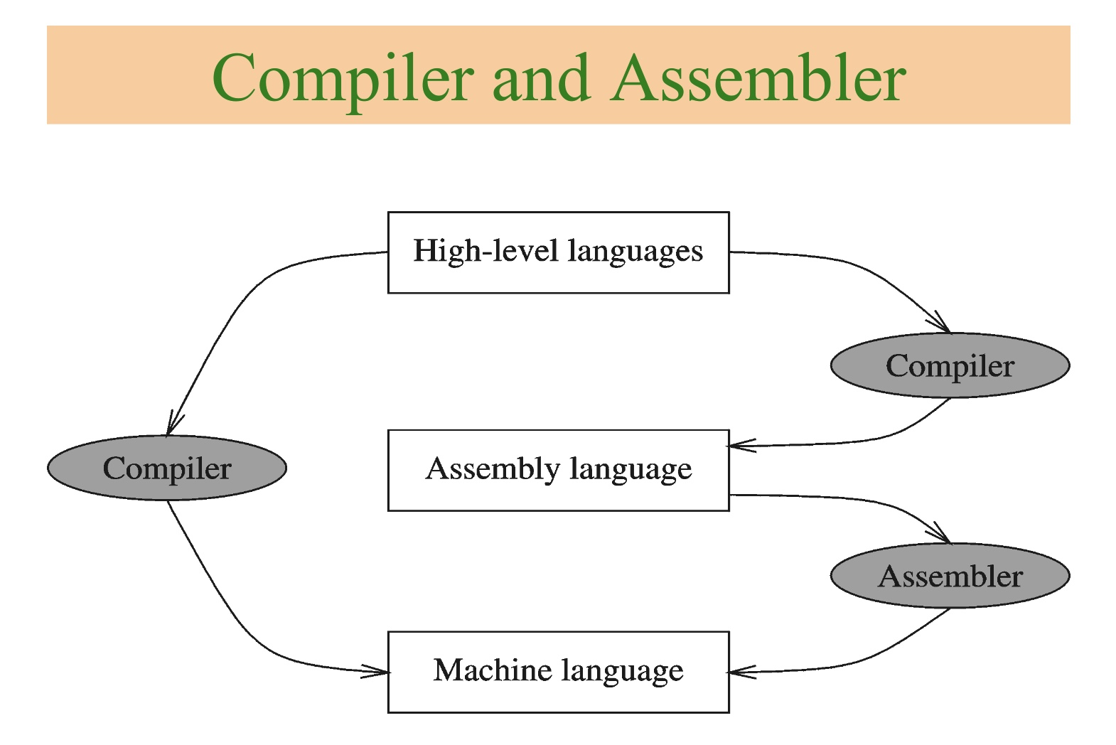

Slide 14
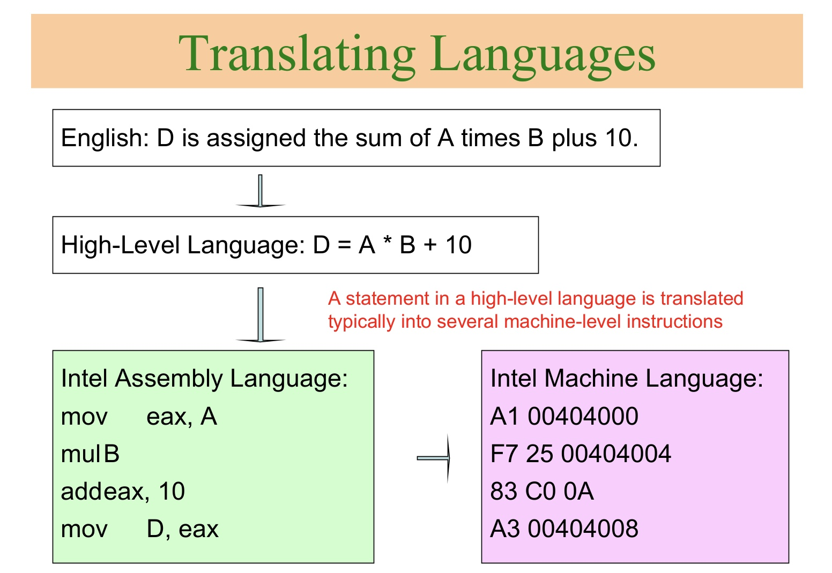

Slide 15
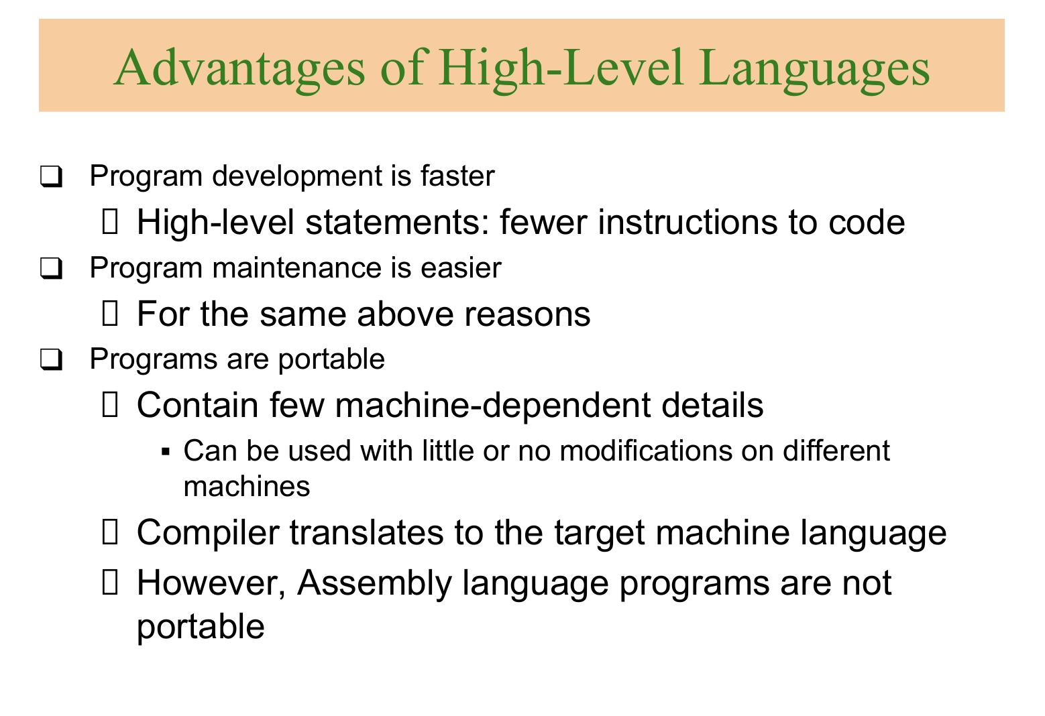

Slide 16
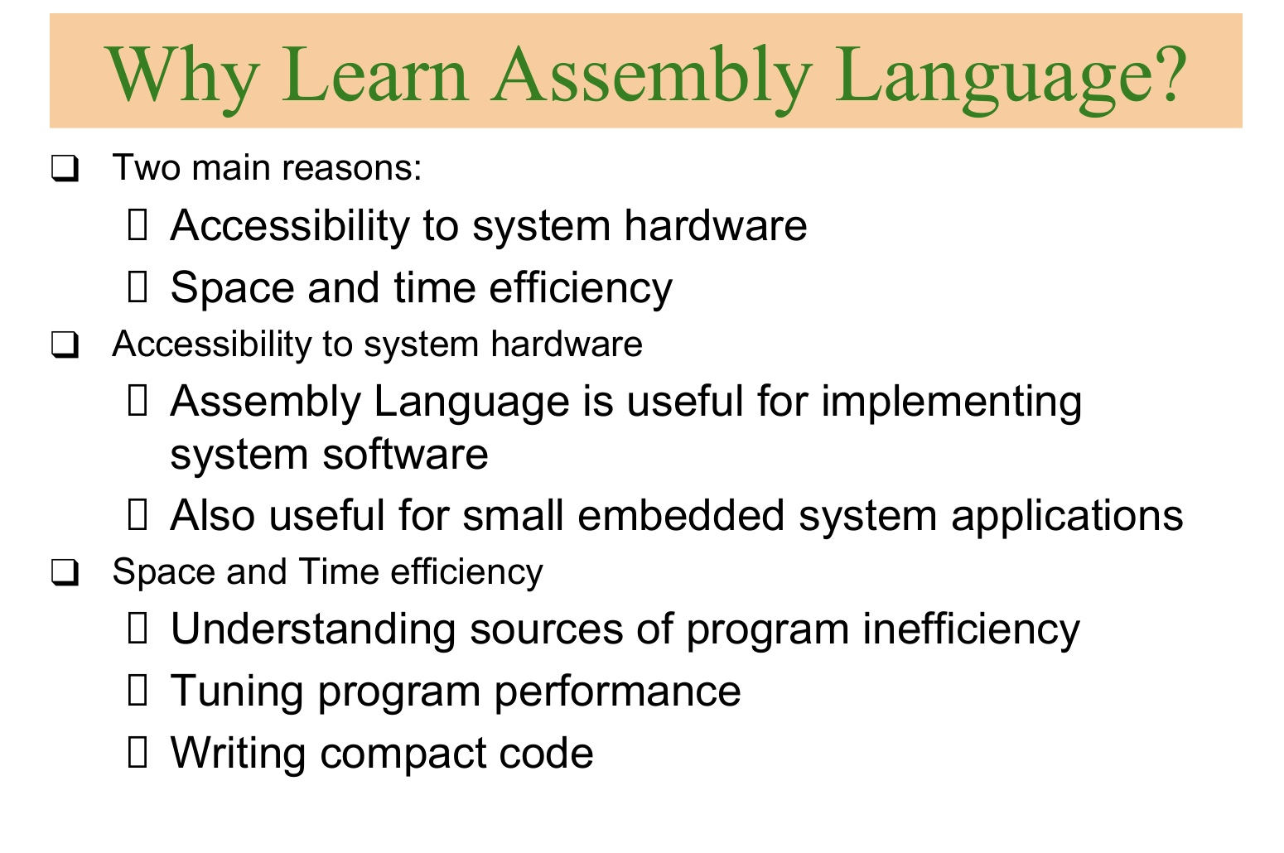

Slide 17
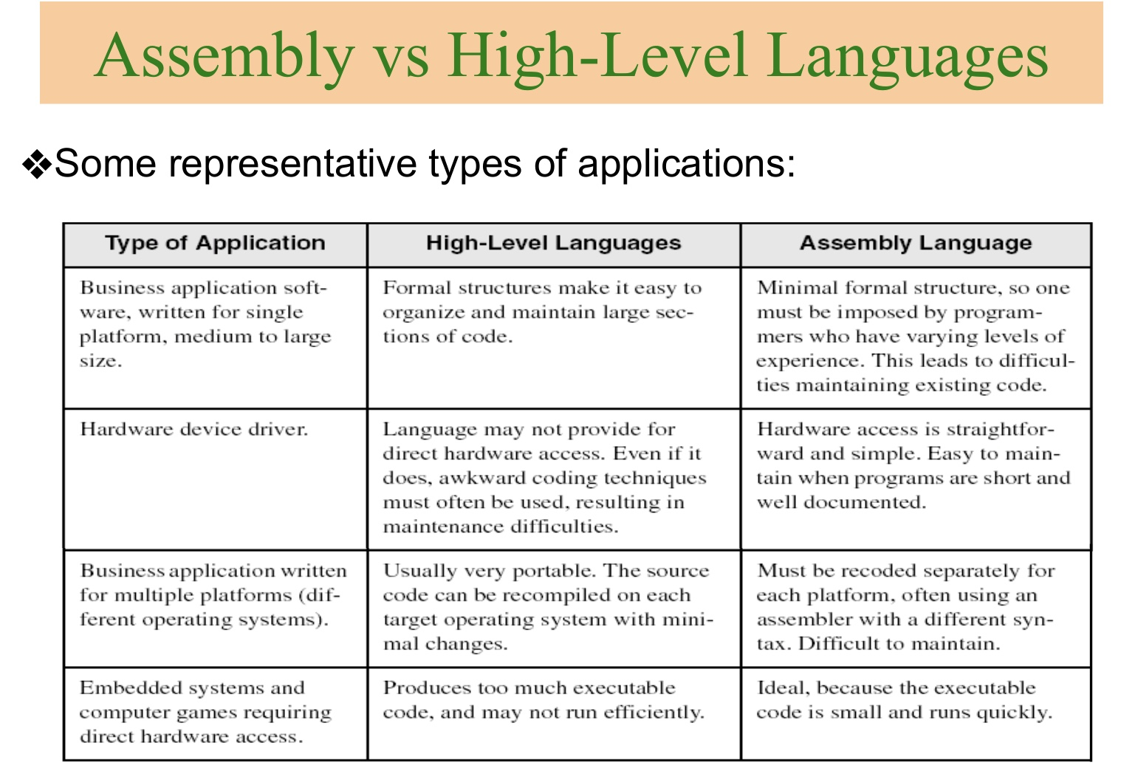

Slide 18
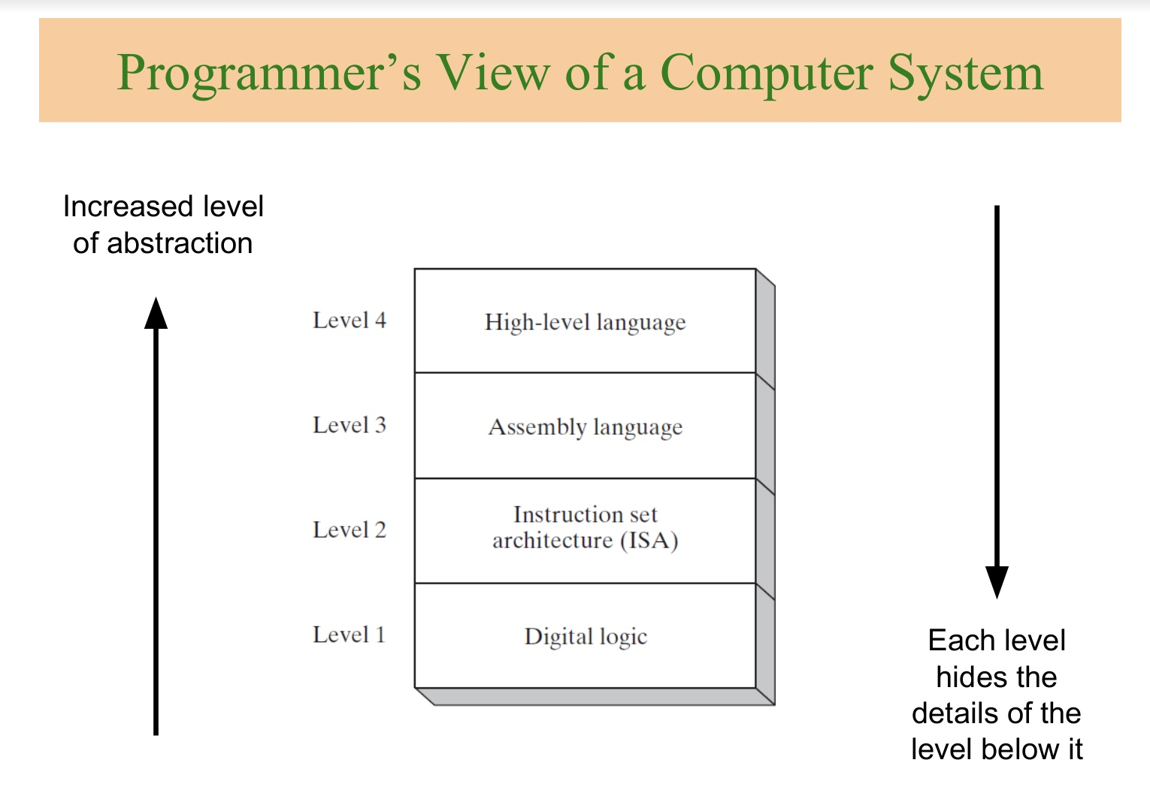

Slide 19
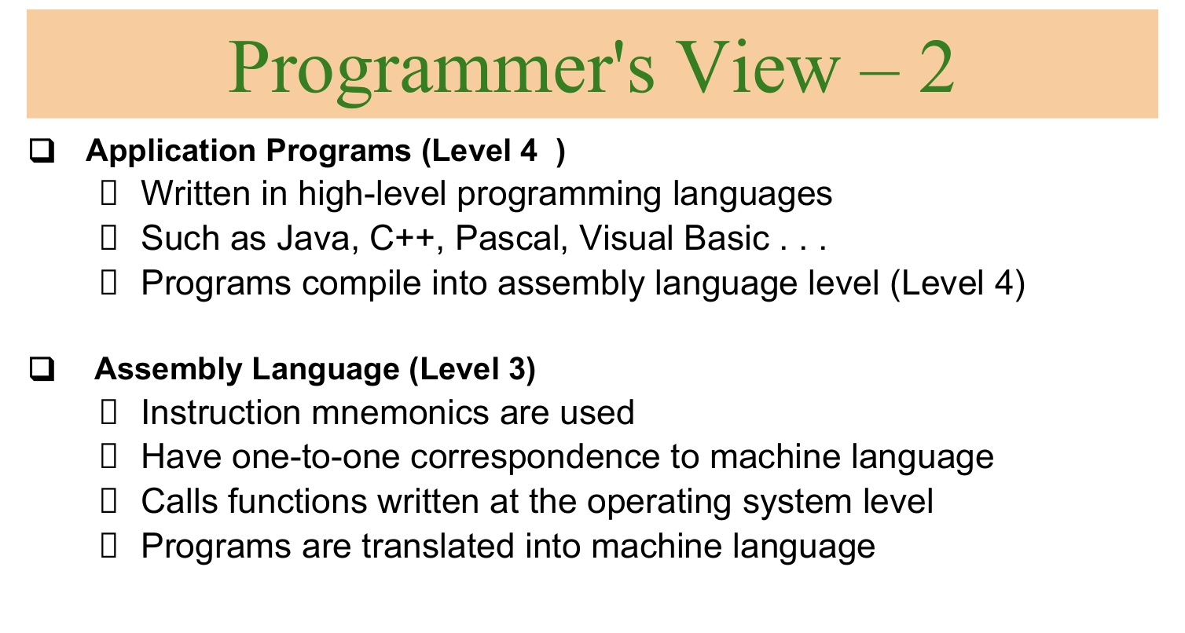

Slide 20
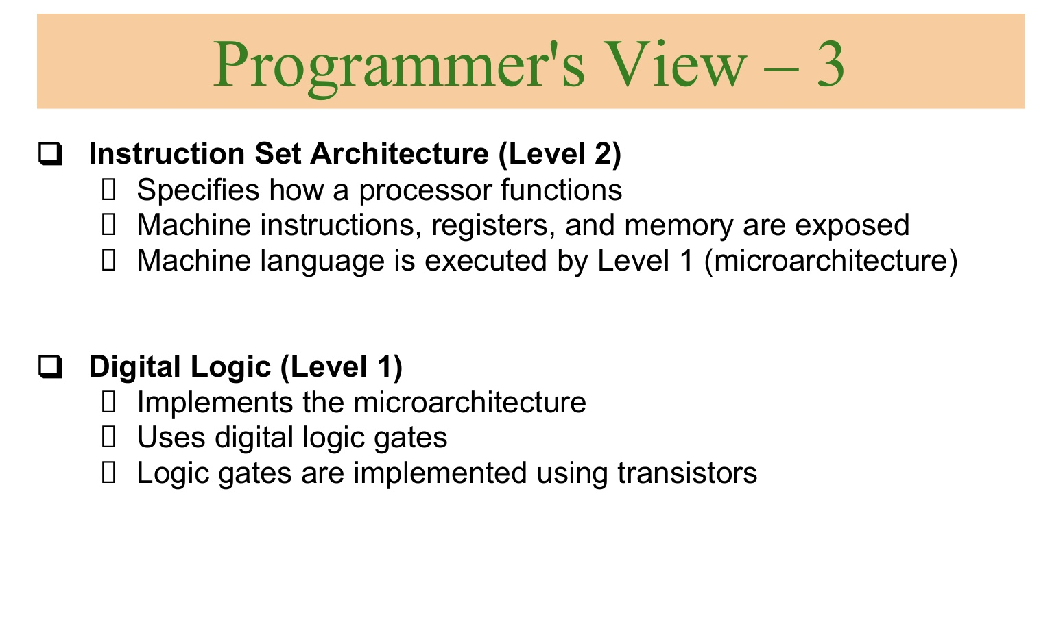

Slide 21
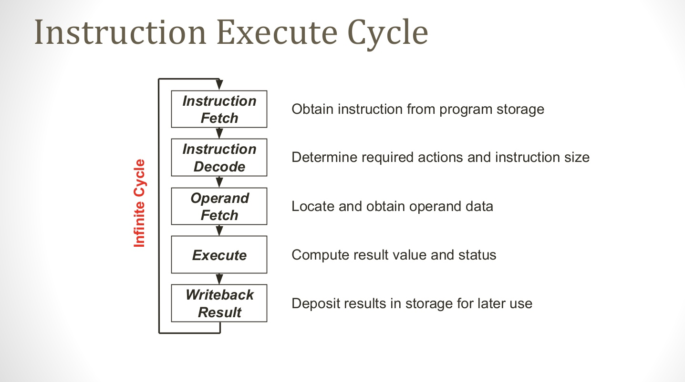
Instruction Execute Cycle

Slide 22
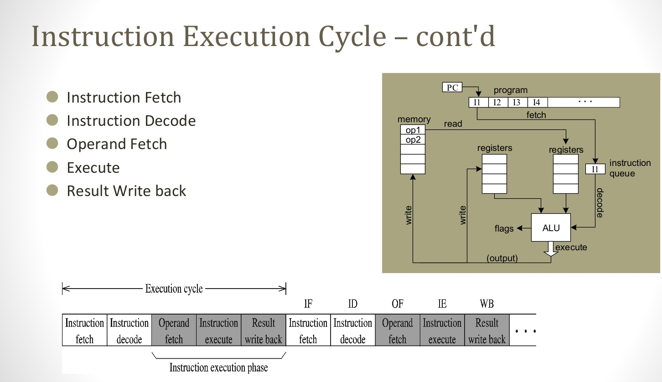
Instruction Execute Cycle.. cont’d

Slide 23
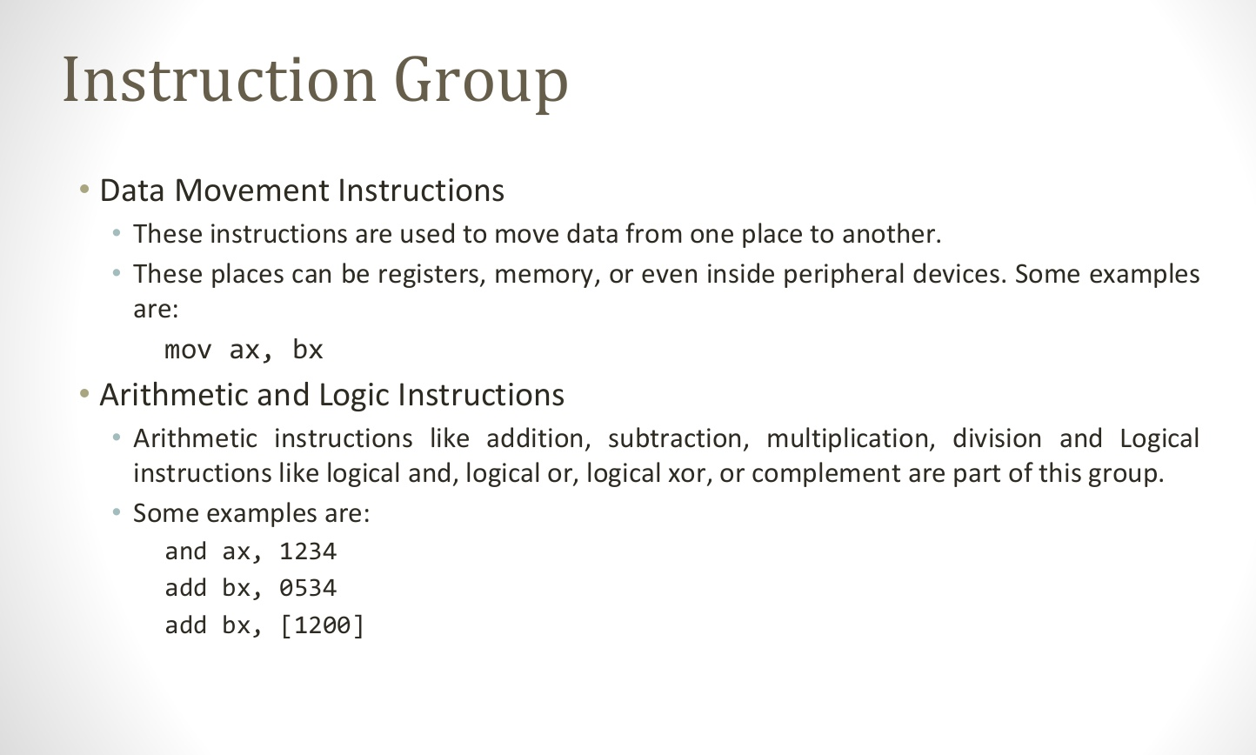
Instruction Group

Slide 24
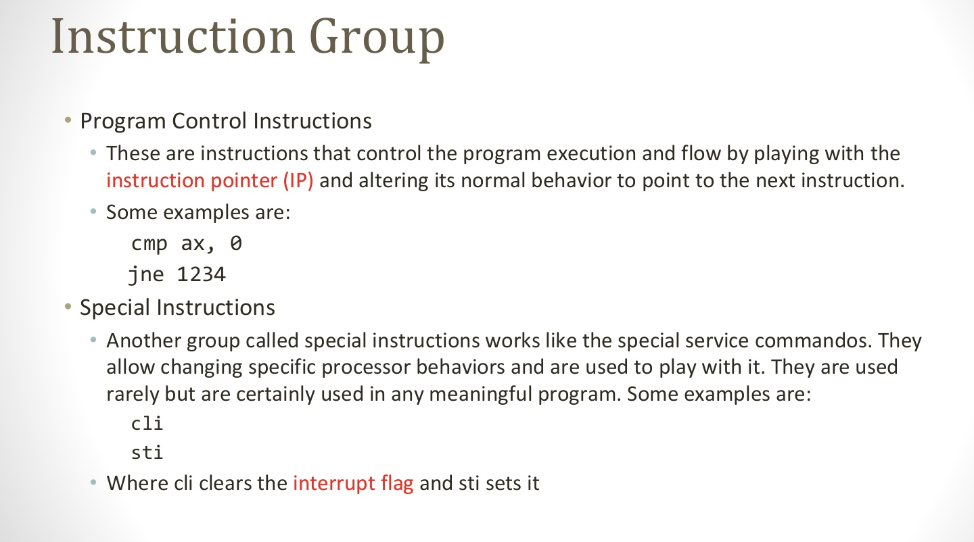
Instruction Group

Slide 25
